Slide 1
IRONBANK
A TEAM

Slide 2
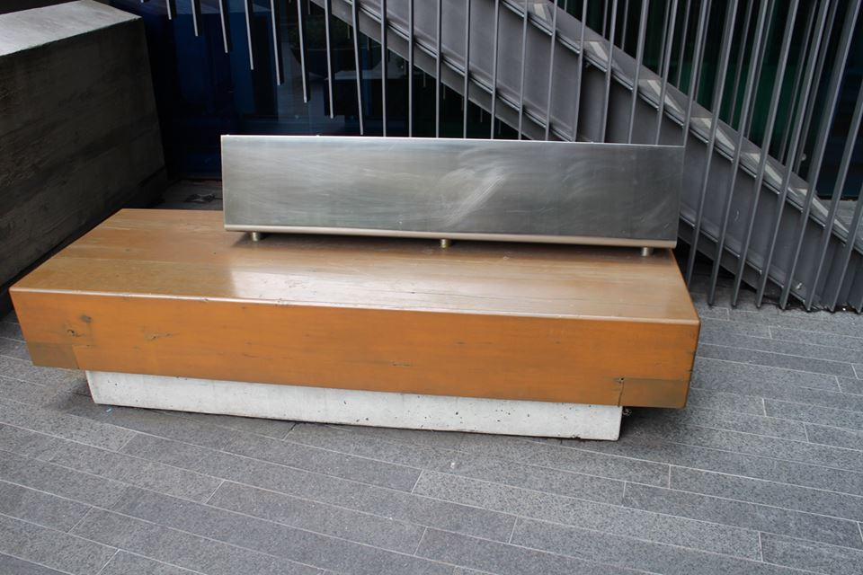
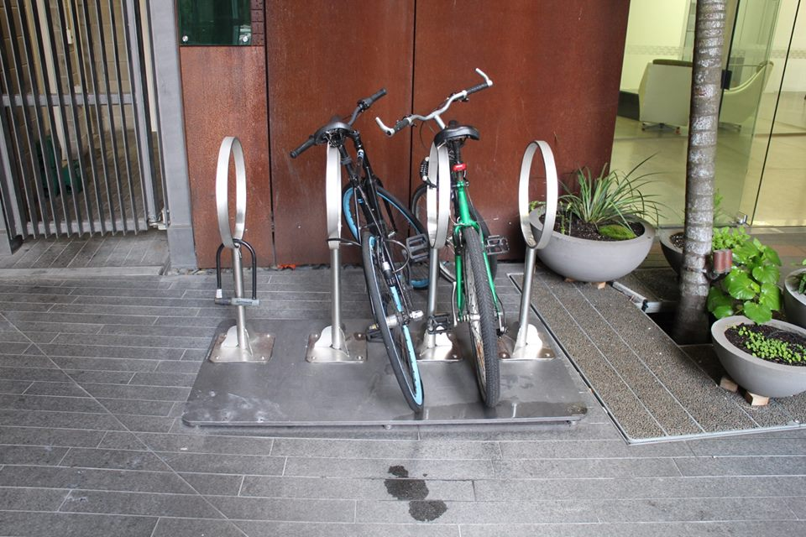
fixtures and furniture
Repetitive use of material, pattern and shape in the bike stand and public seat.
Choice of material surrounding the bike stand breaks up the modern and contemporary feel.
The seat displays a combination of material, proportion and negative spaces, all of which form it’s whole.

Slide 3
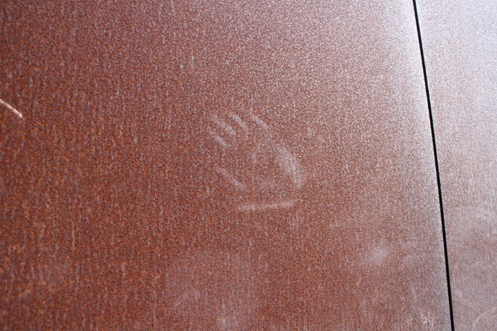
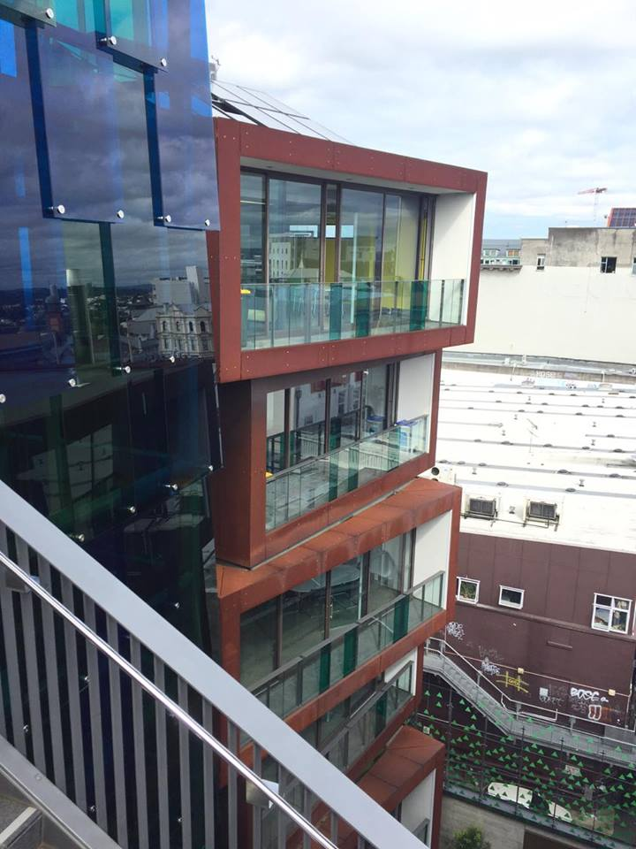
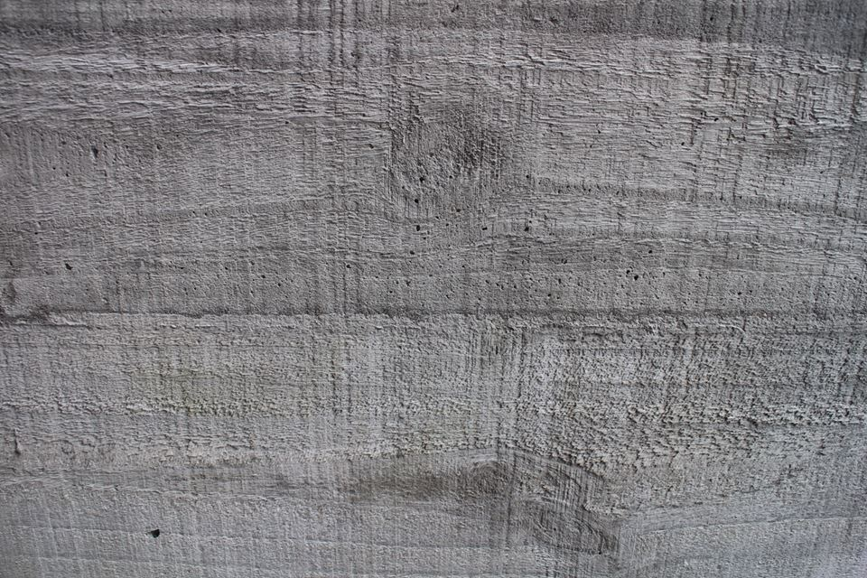
scale and materials used
COR-TEN Steel
Ideal for the cladding as it exaggerates the fragmentation of the building into each separate office.
Eliminates the need for painting and maintenance.
Rough Textured Concrete
Breaks up the solid mass that a smooth wall implies.
Stainless Steel
- Compliments the glass with it’s reflective finish.

Slide 4
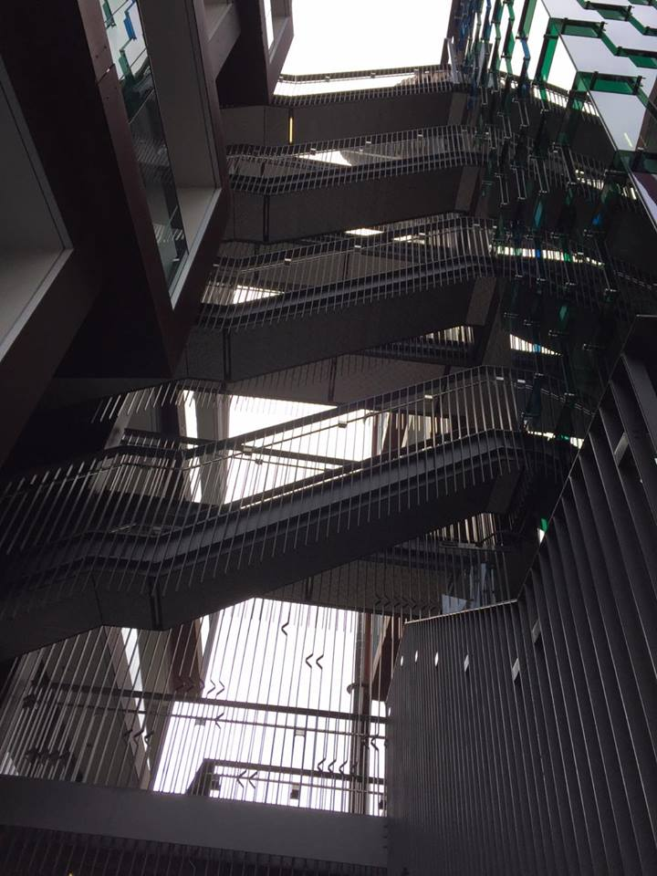
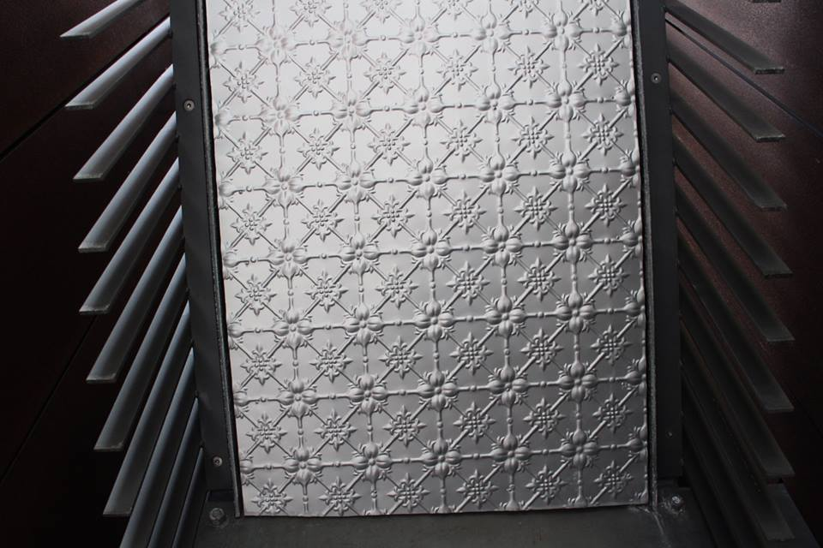
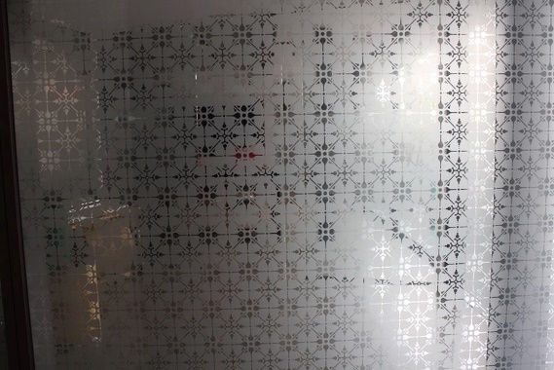
good design decisions
Repetition when using a number of materials
The way the building with the natural contour of the land.
The breaking up of a solid office block by using separate containers which looked like they have been ‘stacked’ atop of each other.
The detail of the patterning and repetition of the block lettering keep the building in keeping with the street.

Slide 5
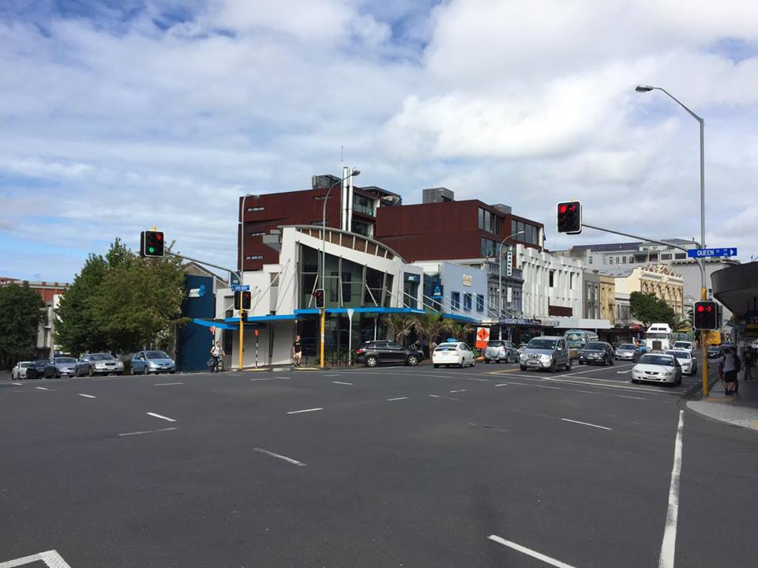
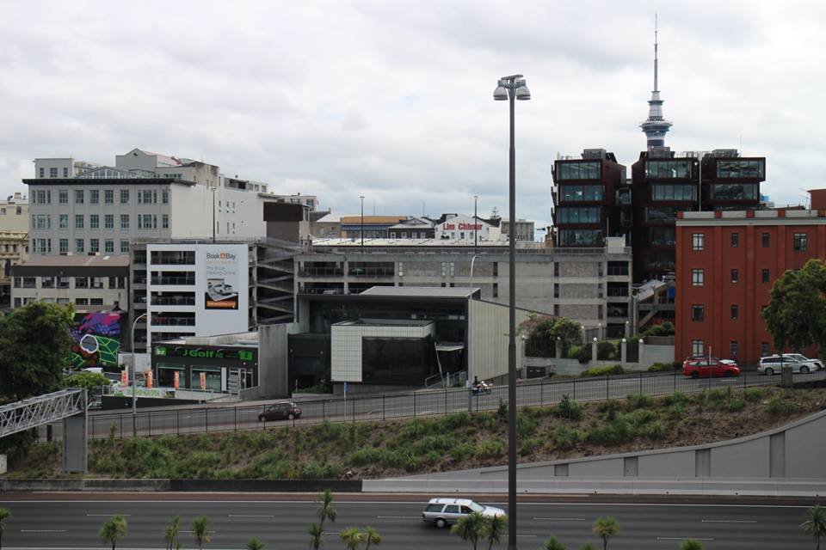
bad design decisions
Aesthetics over functionality?
The separation of offices makes the workspace too fragmented for larger companies.

Slide 6
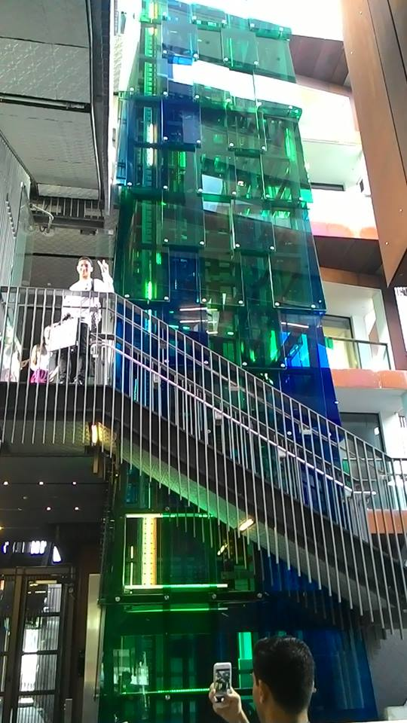
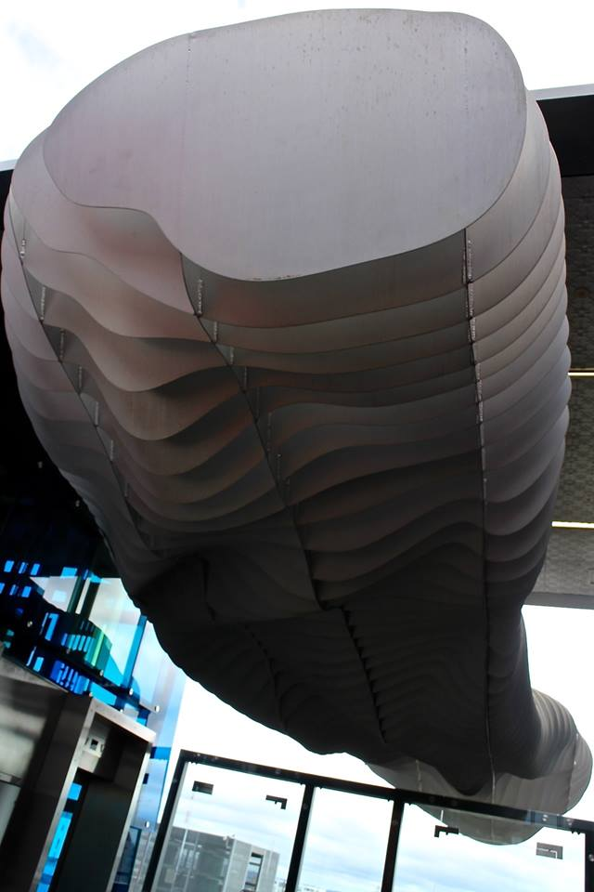
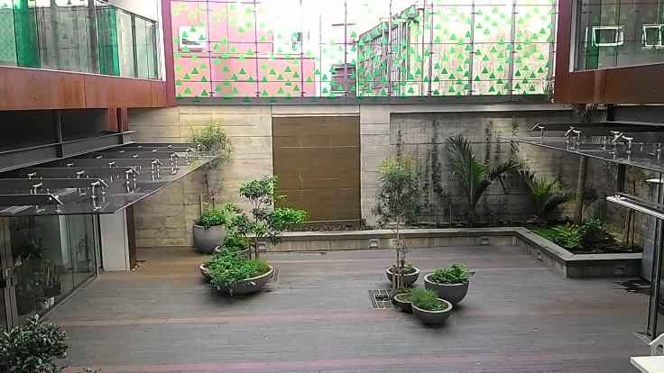
interesting features
Coloured Glass Shift
Draws focus due to the contrast in material of the rest of the building.
Creates a sense of openness through being able to lookout through the glass.
Rooftop Sculpture
The elevation of this steel piece makes it seem light in contrary to the reality of it’s heavy mass.
Organic curving and cloud like outline of the individual planes creates a sense of floating.

